Slide 1
Start-Up Profit Analysis PRDA-01
Name: Ranganatha R
Batch ID: 11-AUG-25-CDA-BUN-040-WDM1130-BAN
Project Team ID: PTID-CDA-NOV-25-934

Slide 2
OBJECTIVE
The main objective of this project is to understand how the money spent on R&D, Administration, and Marketing affects the profit of 50 startups. We collected the data from SQL, cleaned it, did regression analysis to predict profits, and predicting profits for given scenarios, and also built a Power BI dashboard to visualize the patterns. The purpose is to find which spending areas help profit the most, identify where improvement is needed, and give clear suggestions to help the company spend more wisely and improve overall results.

Slide 3

Data Source
The dataset was taken from the MySQL database provided by the institute, which have Table startup in Database Profit_Analysis. It has total 50 rows and 5 columns namely R&D Spend, Administration, Marketing Spend, State, Profit. Later Data was exported to CSV for cleaning and analysis.

Slide 4





Tasks
Got the data from the given SQL credentials and inspected the table and contents.
Exported the data to CSV and performed basic cleaning.
Performed Regression Analysis to understand spending impact on profit.
Predicted Profit for the given input scenarios using the regression model.
Built a Power BI Dashboard with relevant KPIs and visuals.
Derived Insights from all visuals.
Created the final Presentation summarizing the complete project.
For detailed steps, click here: PRDA-01 P A.docx

Slide 5
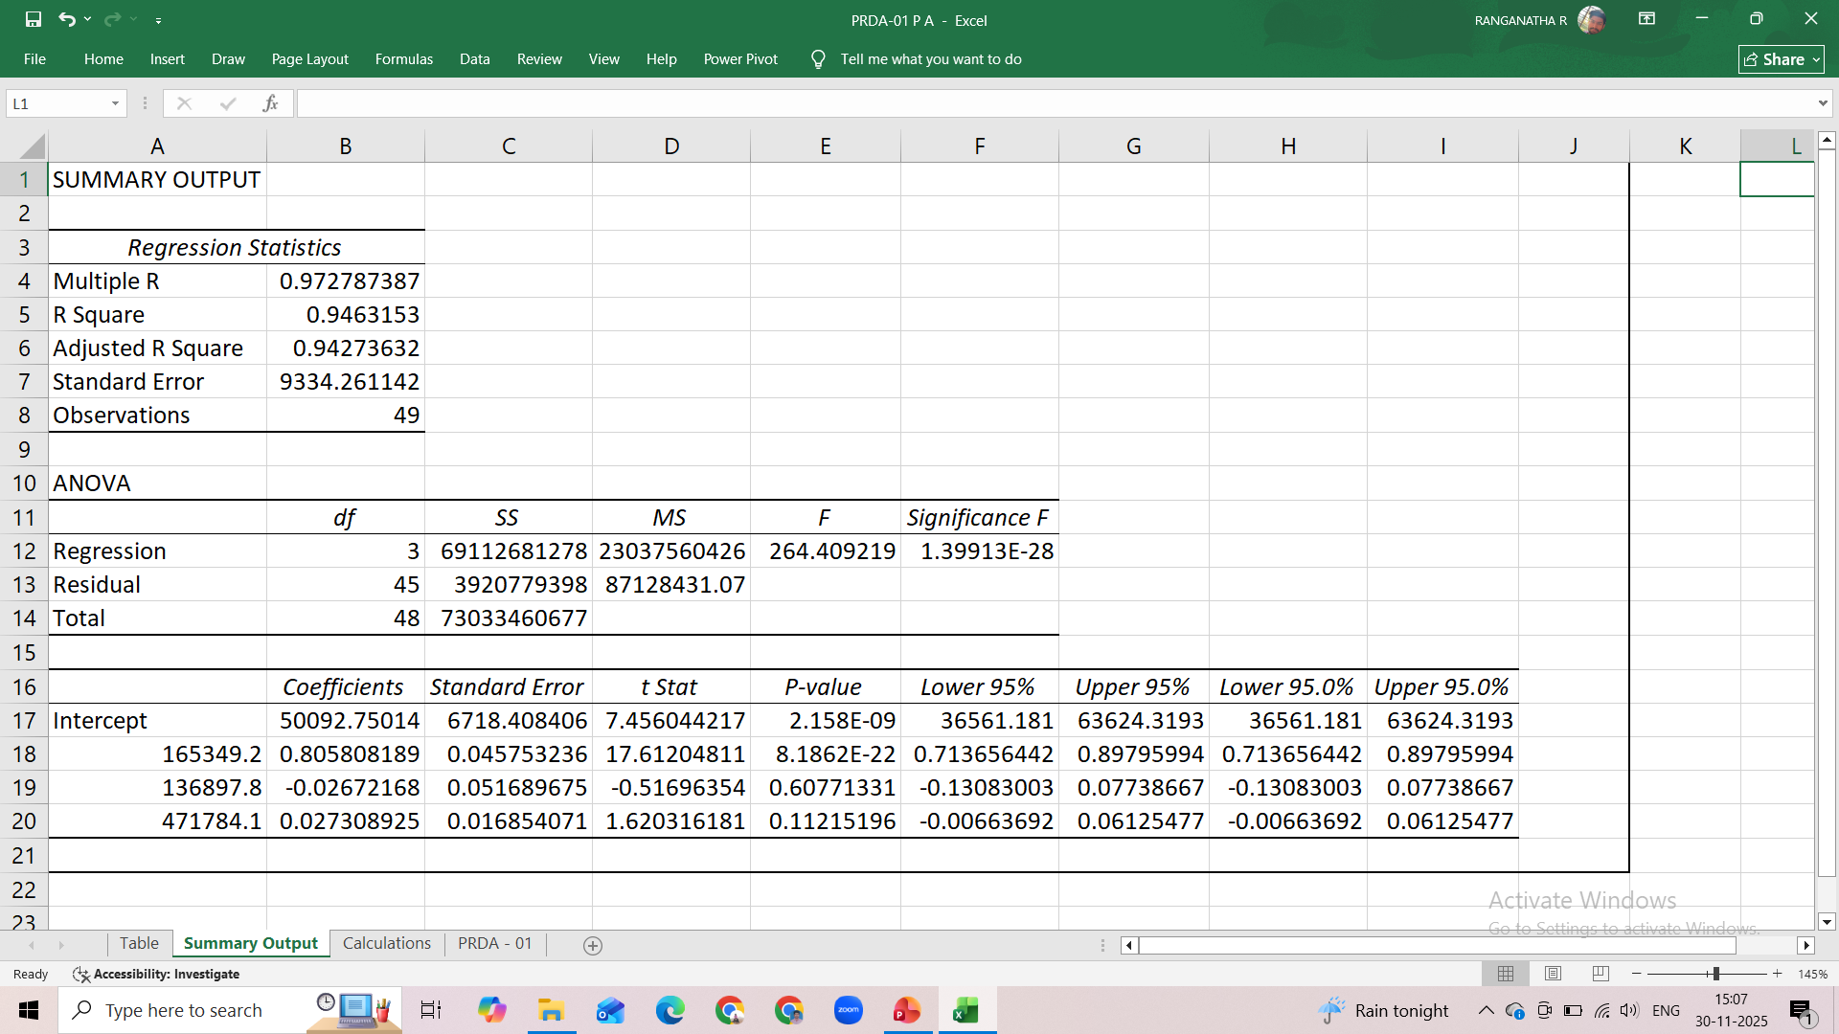
REGRESSION ANALYSIS

Slide 6
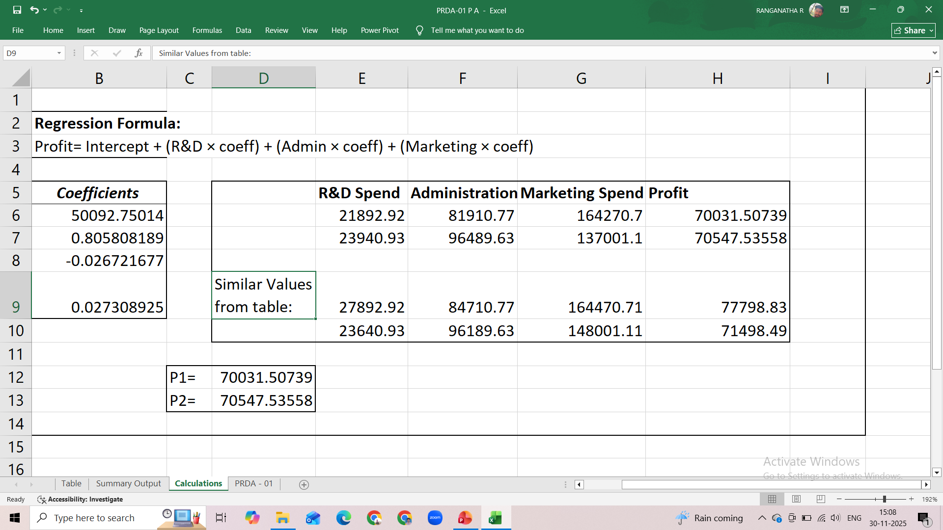
PREDICTED RESULTS

Slide 7
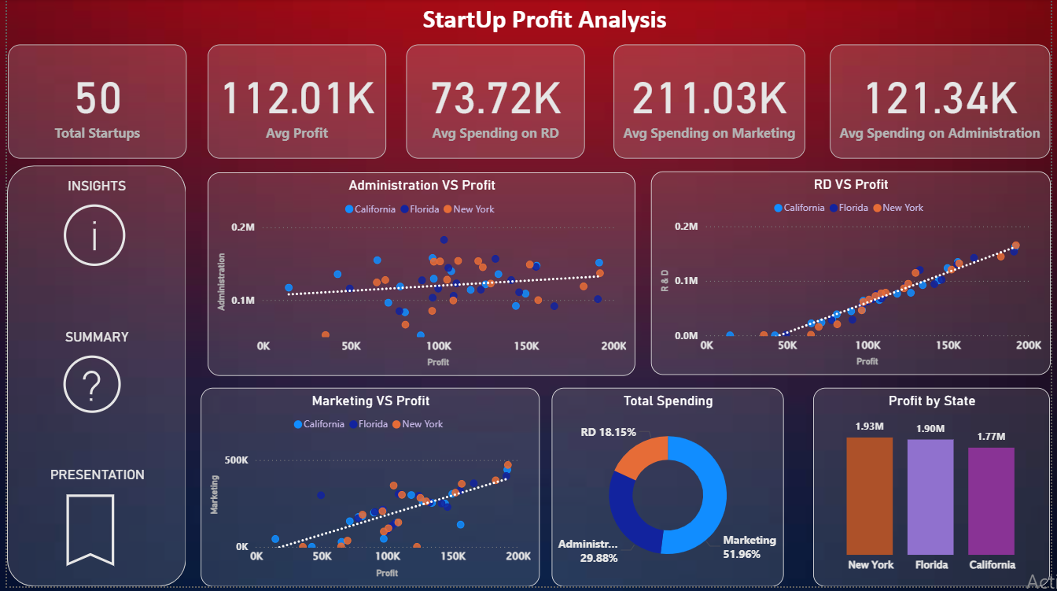
Power BI Dashboard

Slide 8
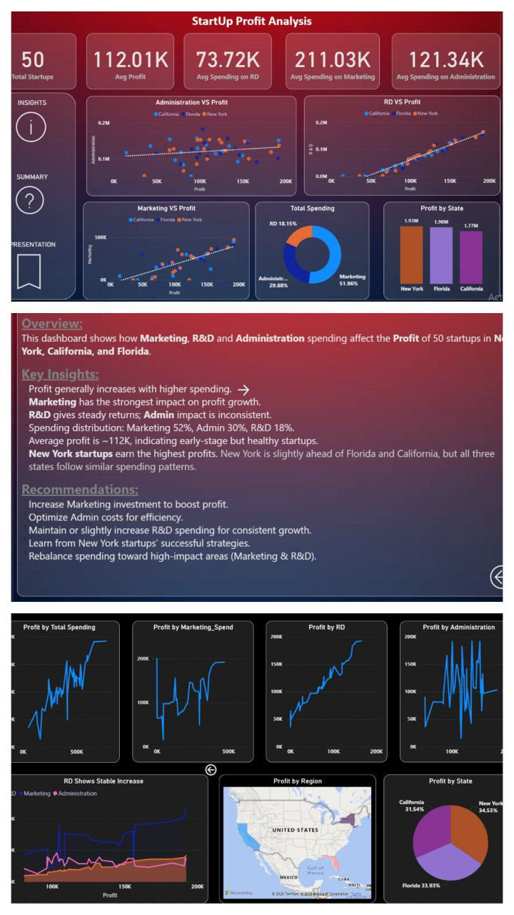
OVERVIEW
This Dashboard shows how Marketing, R&D, and Administration spending affect the Profit of 50 Startups in New York, California and Florida.

Slide 9
Insights
Profit generally increases with higher spending.
Marketing has the strongest impact on profit growth.
R&D gives steady returns; Admin impact is inconsistent.
Spending distribution: Marketing 52%, Admin 30%, R&D 18%.
Average profit is ~112K, indicating early-stage but healthy startups.
New York startups earn the highest profits. New York is slightly ahead of Florida and California, but all three states follow similar spending patterns.

Slide 10
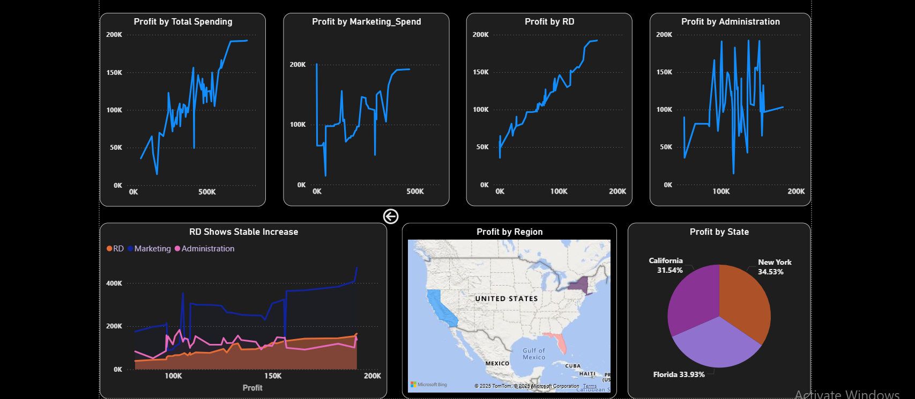
Supporting Visuals

Slide 11
Recommendations
Increase Marketing investment to boost profit.
Optimize Admin costs for efficiency.
Maintain or slightly increase R&D spending for consistent growth.
Learn from New York startups successful strategies.
Rebalance spending towards high-impact areas (Marketing and R&D).

Slide 12
References
Power BI Dashboard:
Click here to download the file:
Excel Works:
PRDA-01 P A.xlsx
PRDA-01 P A.pbix

Slide 13
Thank You

